Slide 1

Title: Scientific Method
What is the scientific method?
Scientific Method is a logical, organized approach to solving a problem

Slide 2
Step 1: Question…what do you want to know?
What is the 1st step of the sci. method?

Slide 3

Practice: Scientific Question or Not?
What is the effect of cigarette smoke on lungs?
Yes!
Why is blue the best color in the world?
No!
Did the grass turn brown because it needs fertilizer?
Yes!
What is the effect of studying time on test grades?
Yes!
Why is basketball a boring sport?
No!

Slide 4


Step 2 Research. Find out what is already known. Make some observations.
Why do we do research?

Slide 5
Step 3 Write a hypothesis.
… what is a Hypothesis?
A suggested answer to the question, based on research and fact, and can be tested.
Usually written: If ____[I do this] ____, then _____[this]_____ will happen.
HYPOTHESIS IS NOT A THEORY:
Theory: a well-tested explanation based on extensive evidence

Slide 6



IF I PUT A PLANT IN MORE SUNLIGHT,
THEN IT WILL GROW TALLER.

Slide 7
Step 4: Test…Do the experiment, Record data, Repeat
How do you find out if your hypothesis is correct?
How do you TEST this hypothesis?

Slide 8
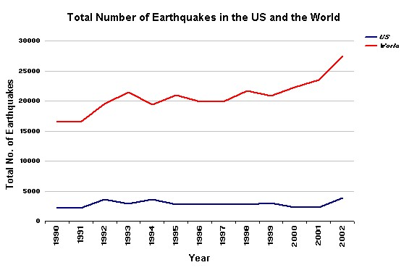
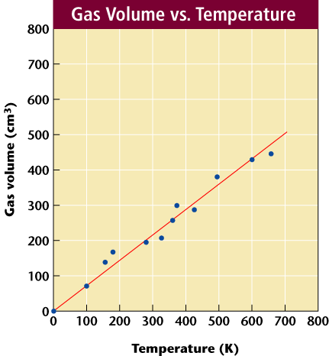
How do you organize data?
Step 5: Analyze…Organize data using graphs, tables and charts, Look for trends

Slide 9

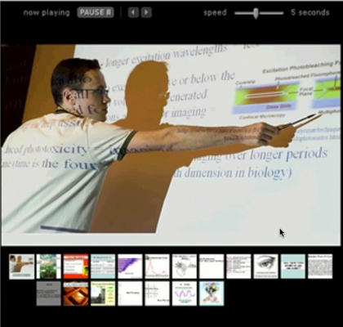
_________________________________________?
Step 6: Communicate Conclusion…
Check the hypothesis (was it supported or not?), Summarize results, Ask new questions…

Slide 10
Results can lead to theories and laws.
Theories have many tests to support.
Laws have many tests and mathematical proofs to support

Slide 11
STATES OF MATTER
State: What form/version/type.
Matter: What everything is made of.

Slide 12
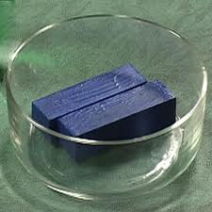
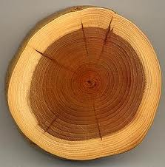
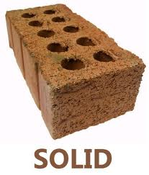

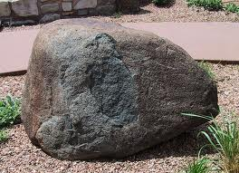
SOLID

Slide 13

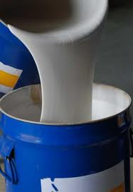

LIQUID

Slide 14



GAS

Slide 15
GAS
ADD HEAT
LIQUID
REMOVE HEAT
SOLID

